Slide 1
Selected Topics on IoT Networking
Introduction

Slide 2
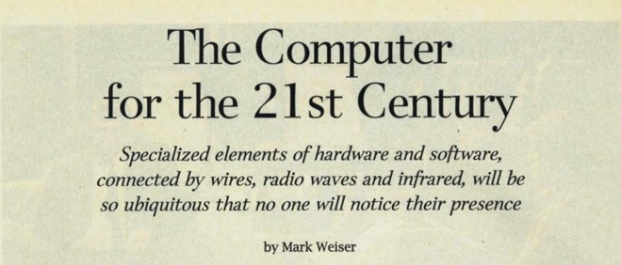
Ubiquitous Computing
Mark Weiser – Xerox PARC, “around” 1988
Mark Weiser, “The Computer for the 21st Century”, Scientific American 3(3), pp 3-11, 1991

Slide 3
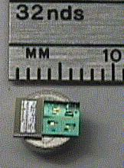
Smart Dust
K. Pister, J. Kahn, and B. Boser, UC Berkeley, 1998 – 2001
Working ‘mote’ smaller than a grain of rice
https://people.eecs.berkeley.edu/~pister/SmartDust/

Slide 4
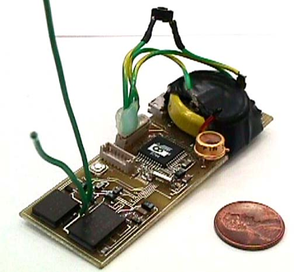
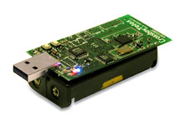
COTS Dust
Crossbow TelosB
Macro-Mote
1999 (RF Mote)
COTS Dust was only ever meant as a transition period, really!

Slide 5
In this unit
The IoT is a very broad topic:
Sensors, Actuators
Smart consumer gadgets
Industrial Applications
Here we will focus on protocols and technologies used in Low-Power, Lossy Networks (LLNs)

